Slide 1
LAND GOVERNANCE IN MALAWI
Edward Chikhwenda, Bester Kasowanjete,
Patrick Kambewa,Regson Chaweza

Slide 2
PRESENTATION OUTLINE
INTRODUCTION
INSTITUTIONAL FRAMEWORK ON LAND GOVERNANCE
LEGAL FRAMEWORK ON LAND TENURE
LAND DISPUTE RESOLUTION
VALUATION AND TAXATION
LAND USE PLANNING CONTROL
MANAGEMENT OF PUBLIC LAND
LAND INFORMATION
LAND GOVERNANCE CHALLENGES

Slide 3
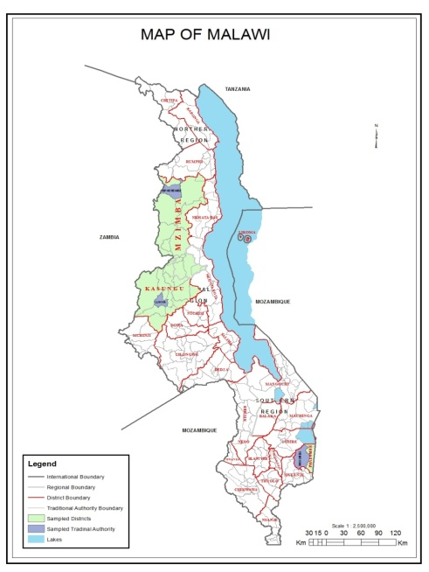
INTRODUCTION
Land Area | 94,080 km²
Water Area | 24,404 km²
Total Area | 118,484km²
Population | 18,570,321
Population Density | 197.39/km²
Government Type | Presidential Republic
GDP (PPP) | $21.20 Billion
GDP Per Capita | 1,100$

Slide 4
BACKGROUND
Malawi land locked formerly Nyasaland (1891 to 1964)
Early inhabitants were nomads
Land use characterised by conquest
1884, Berlin Conference defined the current boundaries
1891 Nyasaland became British Protectorate
Introduction of dualism of land tenure
Categories of land: Crown, Native Trust, Private
Certificate of Claim used to convert NTL into Private.

Slide 5
background
At Independence, land was categorised as Public, Customary and Private(Leasehold, Freehold)
Malawi was under one party system from 1964 to 1994
After attaining multiparty system Commission of Inquiry on Land Reform established.
Malawi National Land Policy passed in 2002.
In 2016 Land Bills passed by Parliament
In 2017 The President assented the Bills

Slide 6
Institutional framework on land governance
Original land administered based on tribal groupings
1891 marked the introduction of British Legal system
Traditional versus western models resulted in conflicts
Attempts to resolve land issues resulted in several commissions of inquiry
Despite challenges over time, land management and administration is at three levels
Levels include: 1.Central Government 2. Local Government and 3. Traditional level
Notes:
1920 Commission,1938 Bell Commission, 1946 Abraham Commission , 1999 PCLPR

Slide 7
Institutional framework on land governance

Slide 8
Institutional framework
MLHUD responsible policy formulation and implementation
Local authorities responsible for implementing land related policies
Local authorities governed by the decentralisation policy
Other ministries involved in land management and administration e.g Ministry of Agriculture, Ministry of Irrigation and Water resources, Transport and public Works etc
Institutional overlaps exist due to inconsistencies in policies

Slide 9
Legal framework on land tenure
Historically authority to allocate land was vested in community leaders
The British brought the deeds registration system as early as 1916.
Land administration during colonial era was based on British Land Law
1892 African Orders in Council formulated to facilitate the acquisition and granting land rights
1894 Land Survey Regulations- urban land management
1896 Land Sales regulations –purchase and leasing of land
1898 Africa(Acquisition of Lands) Order in Council-to mandate courts in Malawi to adopt British Common law

Slide 10
Legal framework on land tenure
1965 Land Bill-recognised land as country’s greatest asset
Land Act of 1965- Categorised land as Public, Customary and Private(Leasehold & Freehold)
Public Land-occupied used or acquired by the government
Customary Land-all land held, occupied or used under customary law
Private Land-owned, held or occupied under freehold or leasehold or certificate of claim
Land Registration Systems include private conveyancing, deeds registration and title registration system.
Deeds registration based on Deeds registration of 1916
Title Registration is/was based on Registered Land Act of 1967(Lilongwe,Blantyre,Mzuzu, Zomba and Karonga)

Slide 11
Legal framework on land tenure
18th March 1996-Presidential Commission of Inquiry Land Policy Reform
2002 National Land Policy adopted (through consultative process)
Malawi Land Reform Programme Implementation Strategy developed to translate NLP recommendations into actions
2016 Land Bills passed in Parliament
2017 Land related Acts assented and Gazetted
Land Act of 2016 aimed at harmonizing existing legal framework with the aspirations of Malawi National Land Policy
Land Act of 2016 has redefined Public Land and Private Land
Customary Land Act of 2016 has been introduced.

Slide 12
Legal framework on land tenure

Slide 13
Land allocation process

Slide 14
Land dispute resolution
Ambiguity of management of responsibility of different types of public land
Several actors are involved in land management
Prior the passing of Customary Land Act of 2016 traditional authorities were involved in land dispute resolution
Tribunals at three levels(TA,District and National)
In the past multiple players(chiefs, District Commissioners)
Chiefs recognised under customary land
Community based system were equitable but had limited/no recognition in the formal judicial system.
In rural areas common disputes are inheritance/famaly followed by boundary/trespass disputes

Slide 15
Land dispute resolution
Formal judicial system include magistrate, high court, appeal courts
Procedure exists for appeal in land cases
Costs are high and take too long and may never be concluded
Arbitration and mediation are other procedures used to solve disputes
Land disputes account for less than 10% of total cases in the formal system

Slide 16
Valuation and taxation
Property taxes assessed based on Quinqenial Valuation Roll and Supplementary Valuation Roll
Local Councils are responsible for tax collection
Failure to collect taxes due to lack of capacity and resources
Land tax is based on market prices
Accessibility to valuation rolls because centrally kept
Annual tax collections depend on amount of ratable value, rate levy and rate collection efficiency
Challenges include under collection due to delays in renewal of valuation rolls and lack of capacity to enforce compliance.
Parishes, churches and cemeteries are exempted from property tax while schools and hospitals are on half rate.

Slide 17
Valuation and taxation
QVR is mainly applicable in urban areas
In urban areas, informal and newly urbanised areas are also excluded
Councils fail to control new developments in urban areas
Lack of information on the number of properties in their jurisdiction
Only 12 out of 38 local government areas are declared ratable areas
Low compliance by property owners to pay taxes result in the whole process of tax collection to be very high.

Slide 18
Land use planning & control
Land use planning framework & process
Physical Planning acts (1988) & (2016) provides for inclusive planning process however;
Institutional framework is generally centralized, i.e. decentralization of the sector is slow
The composition of relevant governance structures, i.e. planning committees, are experts dominated
The system continues to be marred with structural issues such as;
Inadequate human and financial capacity
Persistence of the view that planning is a technical undertaking
Inadequate political will to support the implementation of laid down regulations, i.e. Physical Planning Guidelines and Standards

Slide 19
Land use planning & control
Delivery of services, development permits & land use control
The main deliverables of this system are;
Planned and inclusive settlements
Timely issued development permits
Economically productive urban systems
However it has been observed that in practice the situation is as follows;
Delayed issuance of development permits, i.e. months after the specified period of 30 days
In 2011 about 70 per cent of the urban population in Blantyre city & elsewhere lived in unplanned/informal settlements
Majoring of the urban residents in cities of Malawi earn their income from the informal sector where security of land tenure is a major issue

Slide 20
Land use planning & control
Climate change & environmental management
The role of planning in dealing with issues of climate change and environmental management is rarely recognized
Most unplanned settlements mushrooming in cities of Malawi are located in environmentally sensitive areas, i.e. floodplains & river banks
This is caused in part by;
Poor monitoring and enforcement of approved plans
Lack of access to serviced land by the urban poor
Questionable land use decisions on the part of potential developers where economic considerations override disaster risk concerns

Slide 21
Land governance challenges
Malawi has developed a comprehensive institutional and legal framework
However, there is lack or limited enforcement
Construction of infrastructure road reserves
Encroachment of public land
Illegal developments on public land
Cultivation on road reserves
Planning standards and regulation inaccessible to the majority
Administrative steps, cost and time required to register on public land
Complexities of land registration is a bleeding place for corruption

Slide 22
Land governance challenges
New legislation not addressed general principles to promote access to customary land
CLA 2016 given responsibilities of customary land governance to an elected body based on western democratic principles
Despite legislative and policy reforms access to land is still mediated by men both in patrilineal and matrilineal societies
Infrastructure development on development on public land
Development without planning permission result in service delivery to be difficult and costly
Political interference poses as a challenge to both the institutional and legal frameworks
Squatter settlements have negative impacts on infrastructure development and management

Slide 23
Land governance challenges
Land acquisition process is bureaucratic and time wasting
Result in corruption
Lack of transparency and efficiency in land access result in corruption
Lack of comprehensive land information system
Lack of comprehensive land profile
Accessibility of land registration information is missing
Overlapping responsibilities result mix-ups between institutions in terms of their roles and responsibilties
Policy overlaps
Overlaps between different levels administration.

