Slide 1
Land Governance in Eswatini By Absalom M. Manyatsi & Saico S. Singwane University of Eswatini
Paper prepared for presentation at the
“2019 Land Governance in Southern Africa Conference”
The NUST-NELGA Hub - Windhoek, Namibia, September, 2019

Slide 2
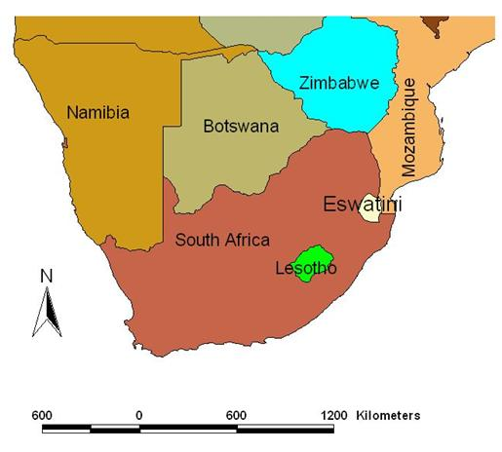
Profile of Kingdom of Eswatini
Area of 17,350 km²
Population of 1,093,238
531,111 (48.6%) males
562,127 (51.4%) females.
Urban population is 21.3%.
Urbanisation is 1.4% per annum.

Slide 3
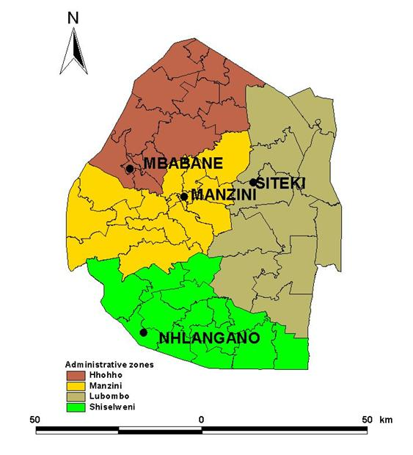
Profile of Kingdom of Eswatini
Country has four administrative region.
Each region is headed by Regional Administrator.
There are 59 tinkhundla centres (constituencies).
There are 385 chiefdoms.
There are several chiefdoms under each constituency.

Slide 4
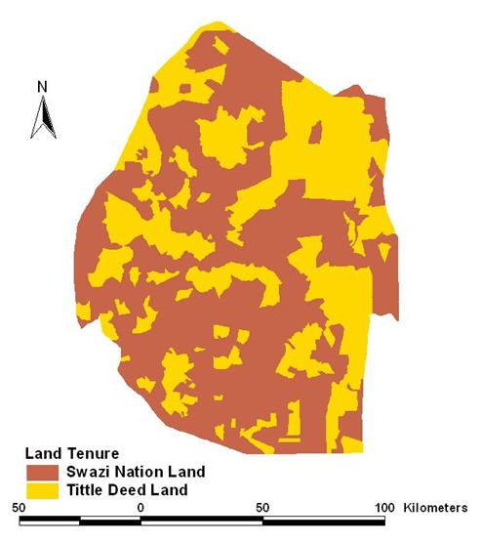
Profile of Kingdom of Eswatini
Two basic land tenure forms.
Title Deed Land (TDL) and Swazi Nation Land (SNL).
SNL covers about 75% & TDL covers about 25%.
Chiefs are traditional land administrators.
Majority of rural Swazis live in SNL, which is subject to customary law and administration.

Slide 5
Land Governance and Administration
Function of Land Agencies | Allocation | Development | Disputes | Resettlement | Subdivision | Use
Traditional Authority (Chiefs) | √ | √ | √ | √ | √ | √
Regional Administration |  | √ | √
Urban Local Administration |  | √ |  |  |  | √
Ministry of Agriculture |  | √ | √ | √ |  | √
MNRE |  |  | √ |  | √ | √
Land Management Board |  | √ | √ | √ | √ | √

Slide 6
Land Governance and Administration
The MNRE through Surveyor General’s Department is responsible for cadastre mapping.
The MNRE through Land Administration Department together with urban local administration is responsible for keeping information on land acquisition in TDL.
The MNRE (Deeds Registry) is responsible for keeping information on land registration and transfers.
The MNRE (Land Valuation Department) and urban local administration keep information of value of land (for TDL).

Slide 7
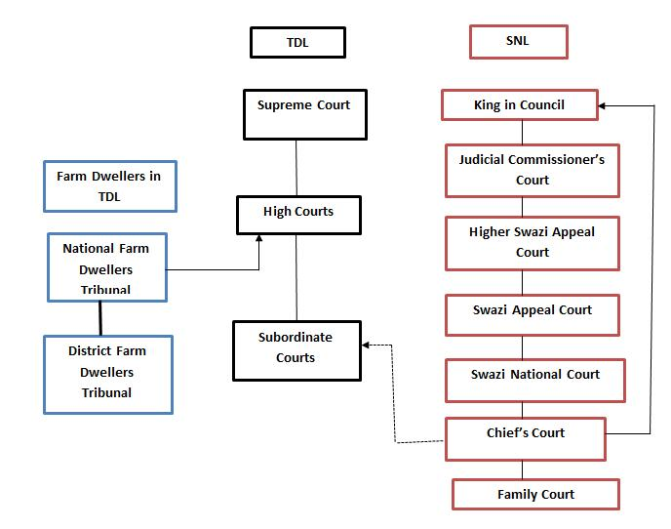
Land Dispute Resolutions

Slide 8
Key Challenges in Land Governance
Delays in enacting legislation to enable proper function of Land Management Board
Lack of information on land boundaries on SNL
Prevalence of forced evictions
Disputes between chiefdoms on boundaries
Lack of land ownership and rights
Dispute resolution mechanism.

Slide 9
Enacting Appropriate Legislation
Land Management Board is responsible for overall management and regulation of land.
It was established by constitution in 2005.
Legislation to make it operation not approved by parliament.
They Include draft Land Policy (2013), Land Bill (2015) and Swazi Nation Land Agricultural Commercialization Bill (2016).
There is perceived conflict between legislation and traditional powers.

Slide 10
Lack of Information on Land Boundaries on SNL
The Surveyor General undertakes cadastral mapping and keeps cadastral information for the whole country.
Cadastral maps are not in appropriate scales for some developments.
Boundaries for chiefdoms have not been adequately identified, verified and mapped.
The operationalization of the proposed Land Act will require verified and agreed upon chiefdom boundaries.
There is lack of National Land Registration System for SNL that will be required to implement Land Act.

Slide 11
Lack of land ownership and rights
People are often compensated when property is taken from them for national developments or any other purposes.
However in SNL compensation is only for improvements on the land, and not for land, as it is not owned.
There is no compensation for customary rights in both SNL and TDL.

Slide 12
Prevalence of forced evictions
The practice of forced eviction is common in both SNL and TDL.
Chiefs would issue eviction orders for customary crimes such as where a resident defied orders from the King.
Farm Dwellers are often evicted in TDL and evictions are ordered by court.
The farm dwellers are evicted without compensation for improvements on land or for loss of customary rights.

Slide 13
Disputes Between Chiefdoms
Inter-chieftain land disputes fracture social relationships, and they divide the residents who may be staying in the same location.
They ordinarily involve boundaries and are usually provoked by development projects.
Inter-chieftain land disputes often result in evictions and retard developments.

Slide 14
Dispute resolution mechanism.
The Farm Dwellers Act regards the owner of a farm in TDL as sole owner of land, and does not take into consideration possible customary rights for dwellers
The powers of traditional local authorities have been eroded in some communities because of chieftaincy disputes and loss of authority and respects by traditional leaders.
The traditional system of appeal on land disputes is too bureaucratic and take too long to resolve issues of land disputes

Slide 15
Thank you

